Slide 1
B.Tech. 8th Semester Major Project Presentation
On
“ Animal Intrusion Detection System ”
Presented by:
Name(s): Abhishek Kr. Rabidas, Siddharth Priyadarshi
Registration Number(s): 1901341007, 1901341032
Branch: Computer Science and Engineering
Supervised by:
Name: Mr. Satyabrat Sahoo
Designation: HOD, CSE
Department: Computer Science and Engineering
Date: 7th June 2023

Slide 2
CONTENTS
Introduction
Literature Review
Motivation
Objective
Methodology
Algorithm Flowchart/Pseudocode
System Design
Data Flow Diagram
Results and Discussion
Screengrabs of Project Environment
Conclusion
References and Bibliography

Slide 3
1. Introduction
Video Stream based Animal Intrusion Detection System(AIDS) with microservice architecture and implementation of remote based IoT system
Detection and inferencing algorithms aligning to wildlife environments
Traditional object detection algorithms failed to give satisfactory confidence in wildlife environments resulting to inefficient real time intrusion detection
Faster inferencing using CNN over the GoCV library to get accurate real time results and RESTful communication for alert systems
Notes:
Most in city not with trees and wildlife
When overlapping algo : we apply NMS -> accurate class is fetched
Intersection over Union NMS : Non maximum separation

Slide 4
2. Literature Review
Ref. | Year | Publisher | Author(s) | Proposed Model | Objective | Limitation
1 | 2023 | Springer | S. Sajithra Varun et al. | Deep-CNN | Animal intrusion detection and classification | Not suitable when animal is partially hidden in bushes
2 | 2023 | Springer | G. Singh Kahlon et al. | YOLOv4 | Early detect and generate alert using surveillance videos | Limited adaptability to new environment
3 | 2022 | Springer | Valli Kumari Vatsavayi et al. | DRCNN-TSOA | Remove unwanted noise from each video frame using Fast Average Peer Group Filter | Model not efficient for detection of animals in nonavailability of light in surroundings
4 | 2019 | Springer | S. Velliangiri et al. | HOS | Intrusion Detection using considerable feature selection | Limited detection accuracy
Notes:
FAPG : Fast Average Pee Group filter : to remove noise from the frame or video
DRCNN-TSOA : Deep Residual CNN –TSO algorithm to perform the video preprocessing
4) HOS : Hybrid Optimization Scheme

Slide 5
3. Motivation
Influence in Food Security
To prevent harm from animal entry
Animal suffer injury when people tackle voluntarily, or they are caught up in risky human activities in these occurrences
Notifying neighbouring inhabitants about intrusion

Slide 6
4. Objective
To create efficient and accurate Animal Intrusion Detection System(A.I.D.S.) which is crucial for various domains, including wildlife conservation , agricultural protection and urban security.
YOLOv4 + GoCV + GoLang to address the challenge of detecting and monitoring animal intrusions
Once detected, the system generates real-time alert ⚠
Notes:
Convolutional Neural Network consists of multiple layers like the input layer, Convolutional layer, Pooling layer, and fully connected layers.

Slide 7
5. Methodology
NVIDIA Deep stream inspired pipeline enabling different engines like capturing streams, decoding , scaling , detection and classification, on screen display(OSD) and output.
Object detection using GoCV (OpenCV library for Golang)
Detection algorithm: YOLOv4
Microservice built in Golang and Echo v4 for alert generation and event persistence
Alert user interface built in ReactJS
Communication between components of AIDS happens using REST APIs

Slide 8
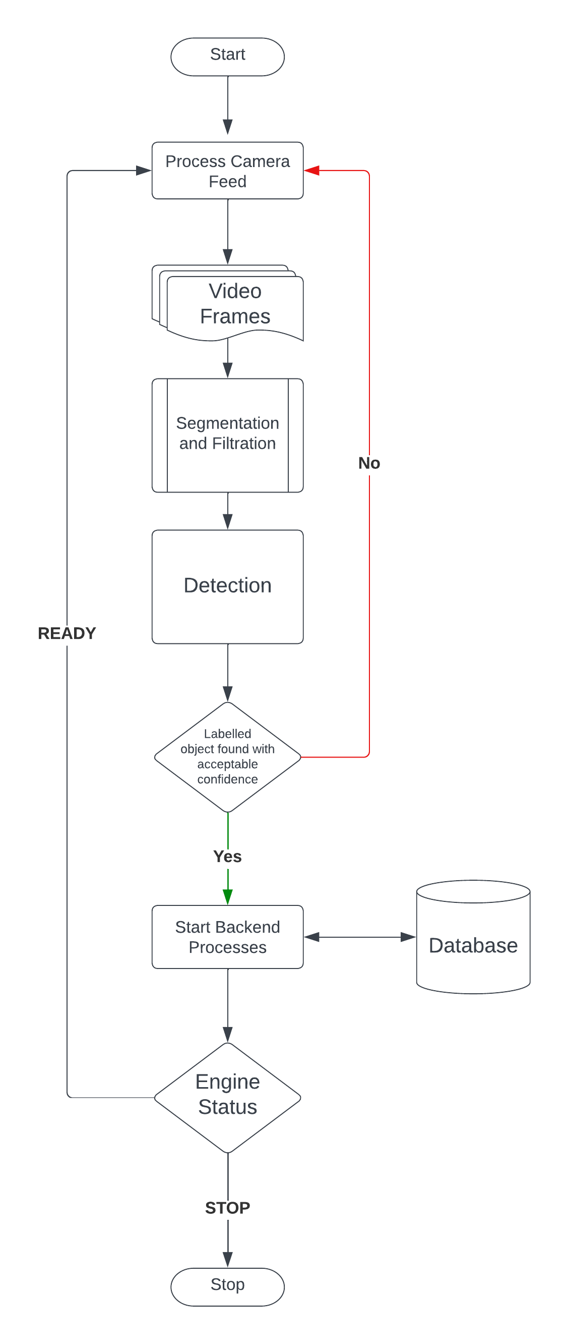
6. Project Flow

Slide 9
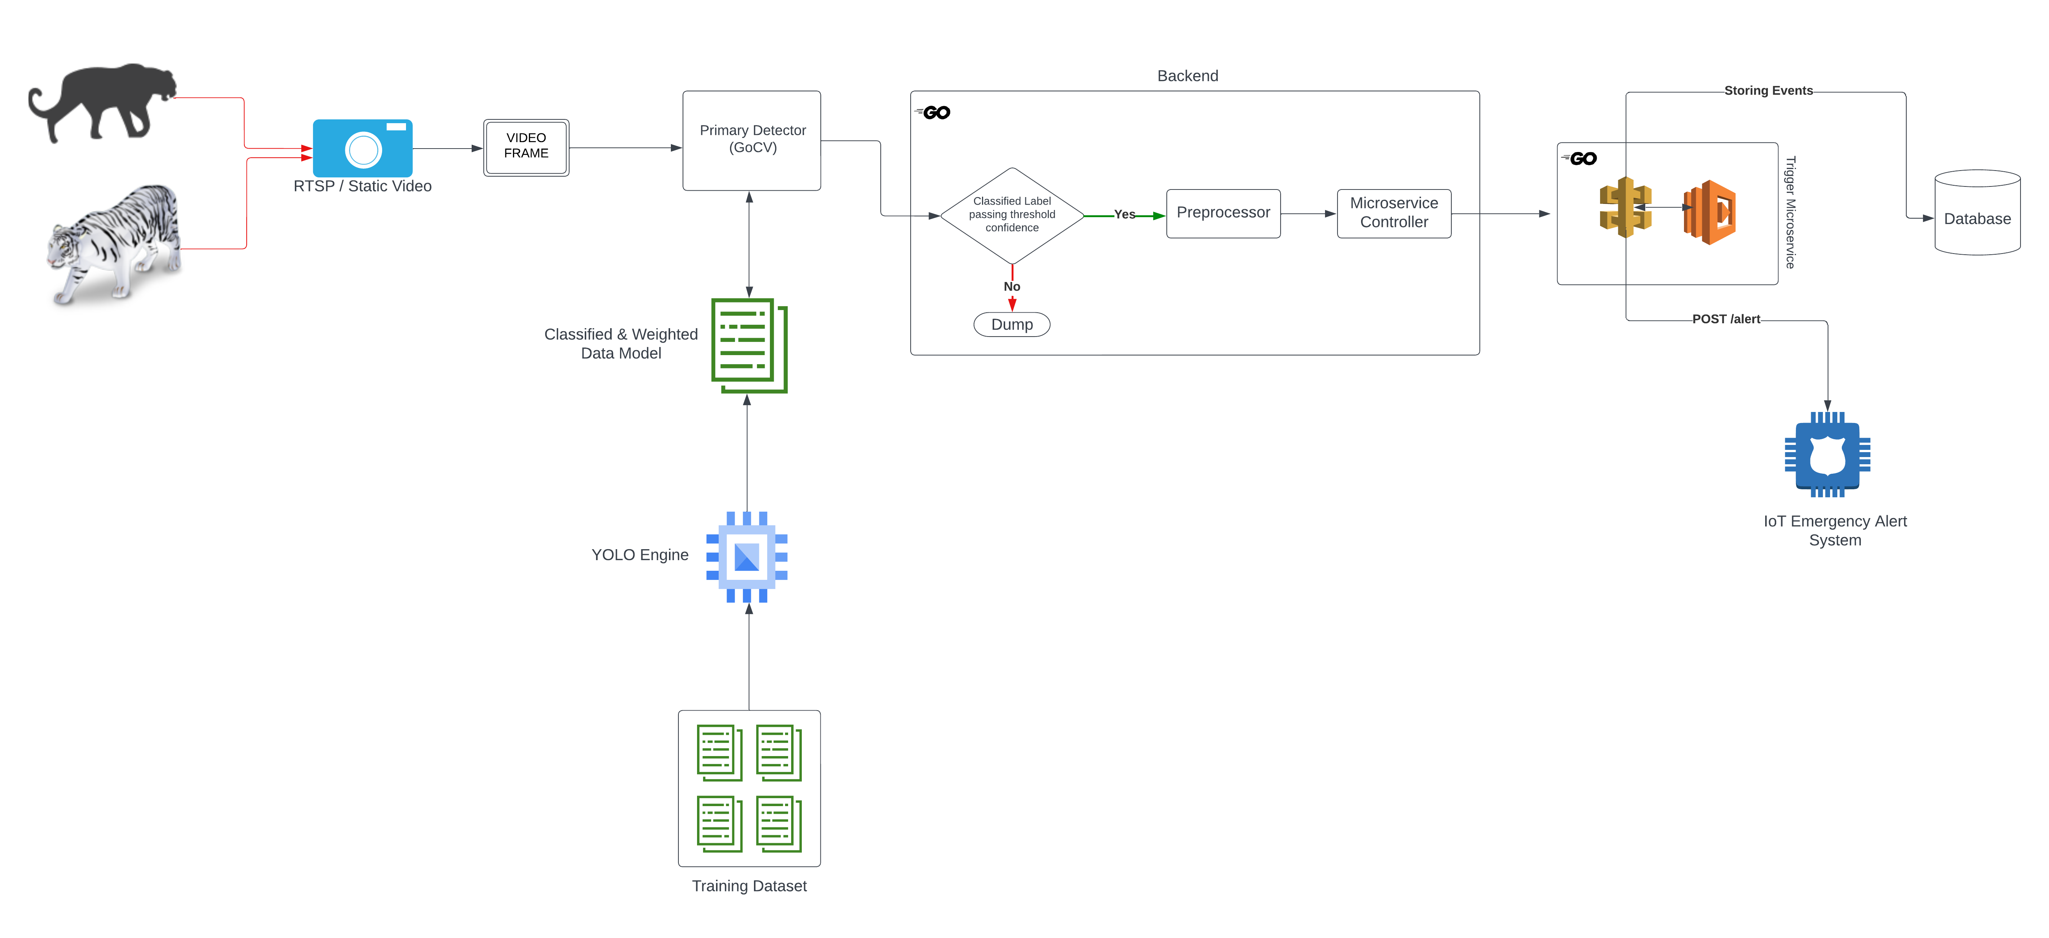
7. System Design

Slide 10
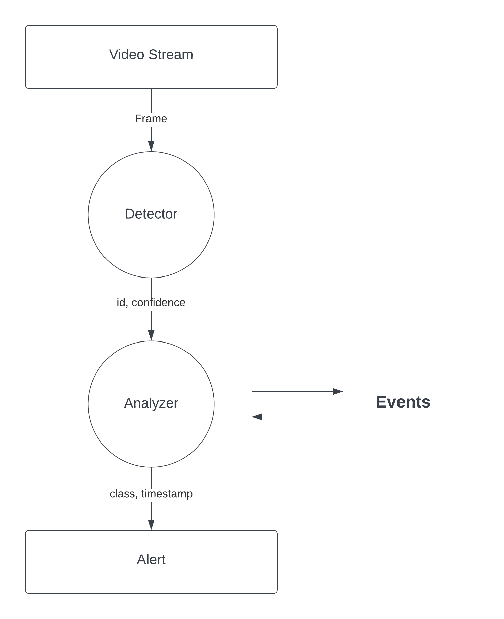
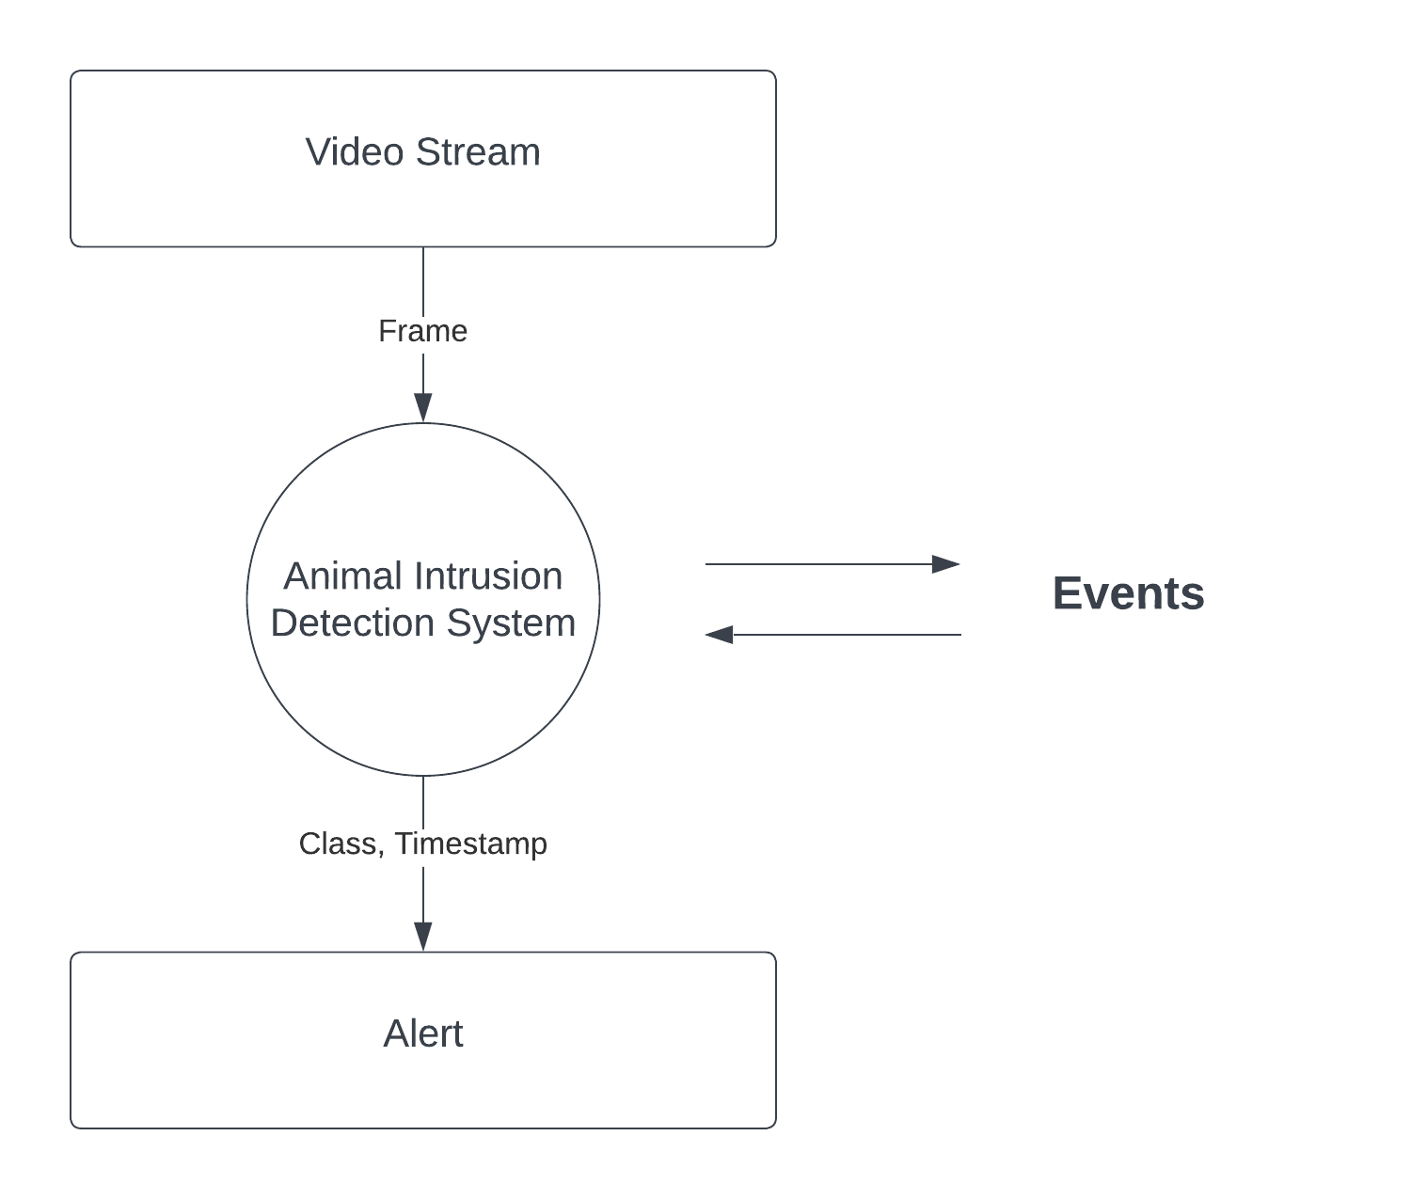
8. Data Flow Diagram(DFD)
LEVEL 0
LEVEL 1

Slide 11
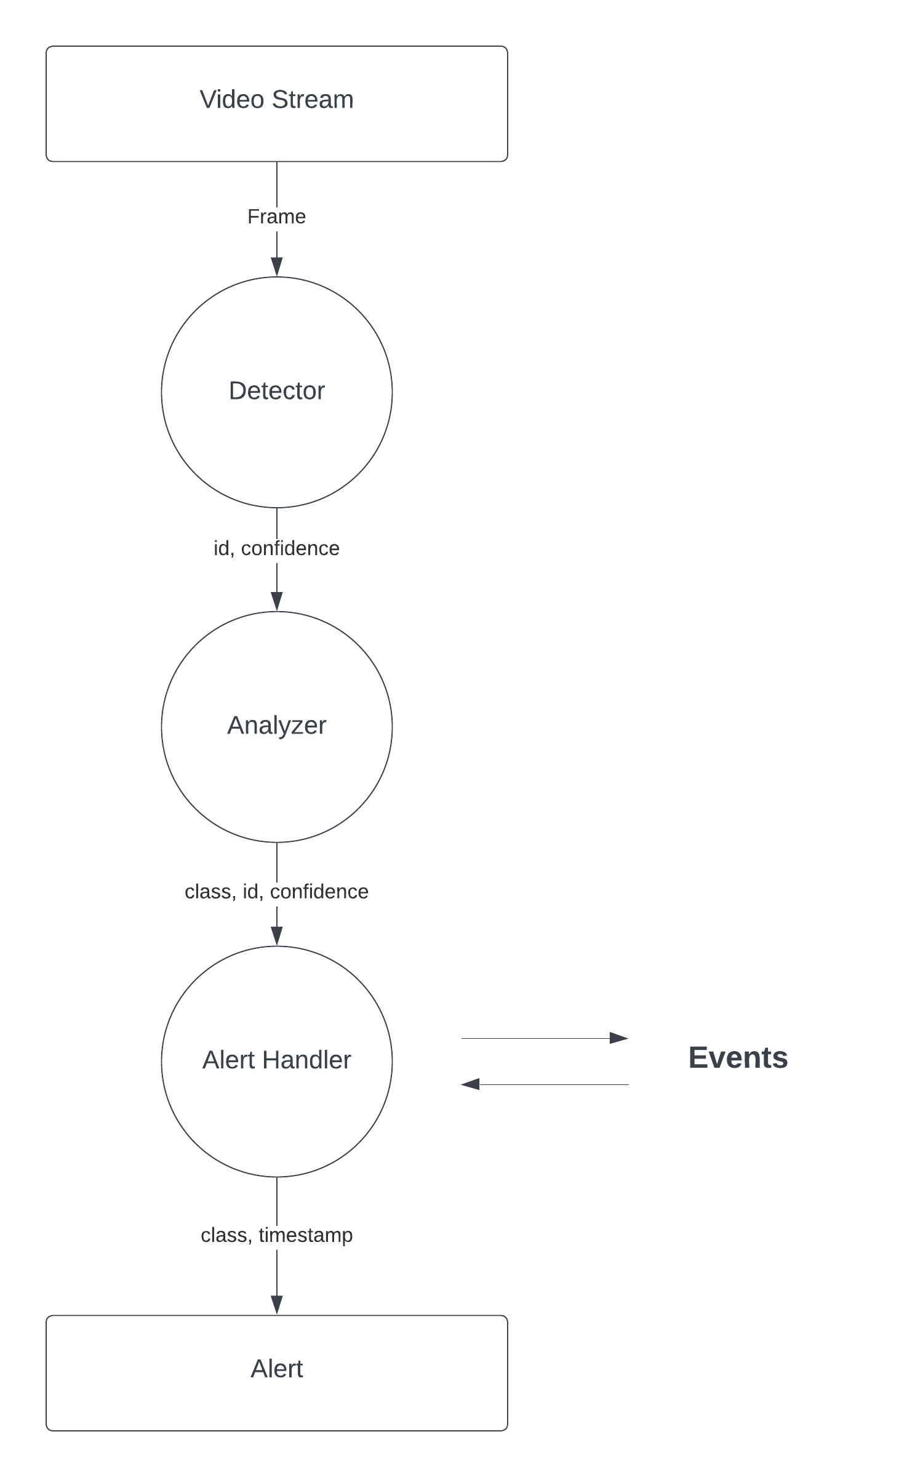
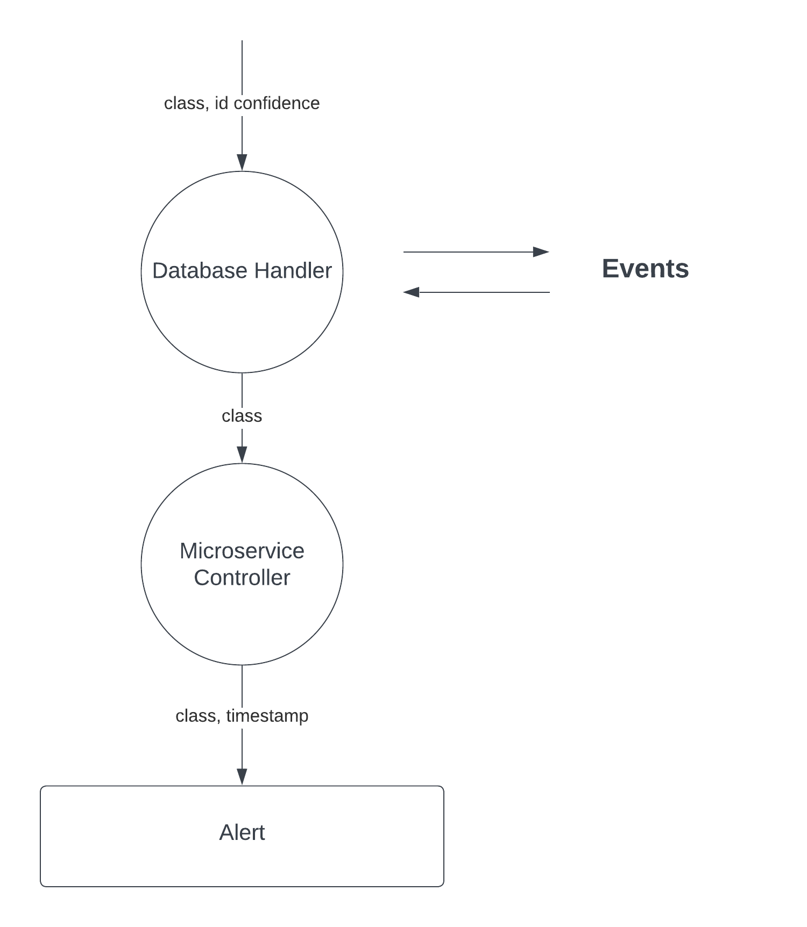
2.1
LEVEL 2
LEVEL 2.1

Slide 12
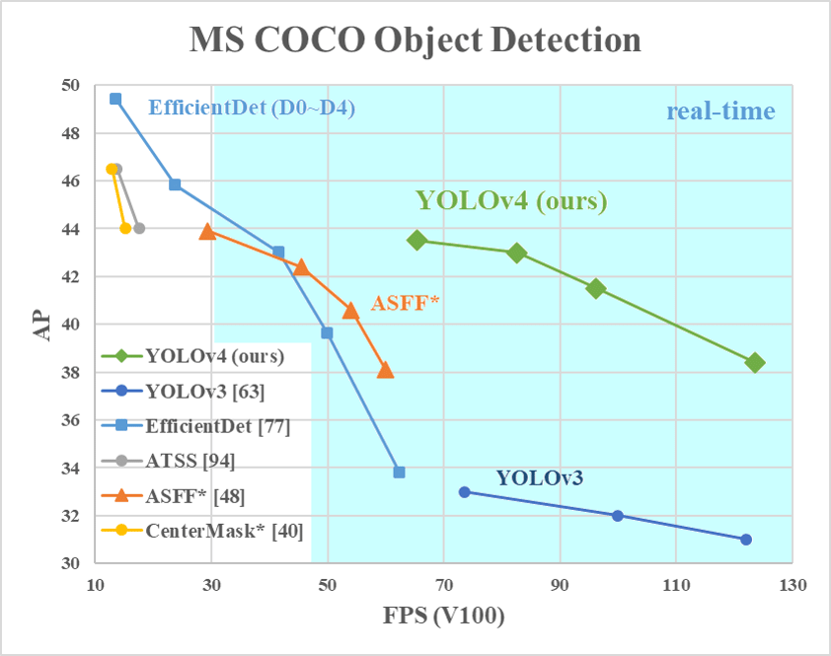
9. Results and Discussion
Notes:
AP : Average Precision
FPS

Slide 13
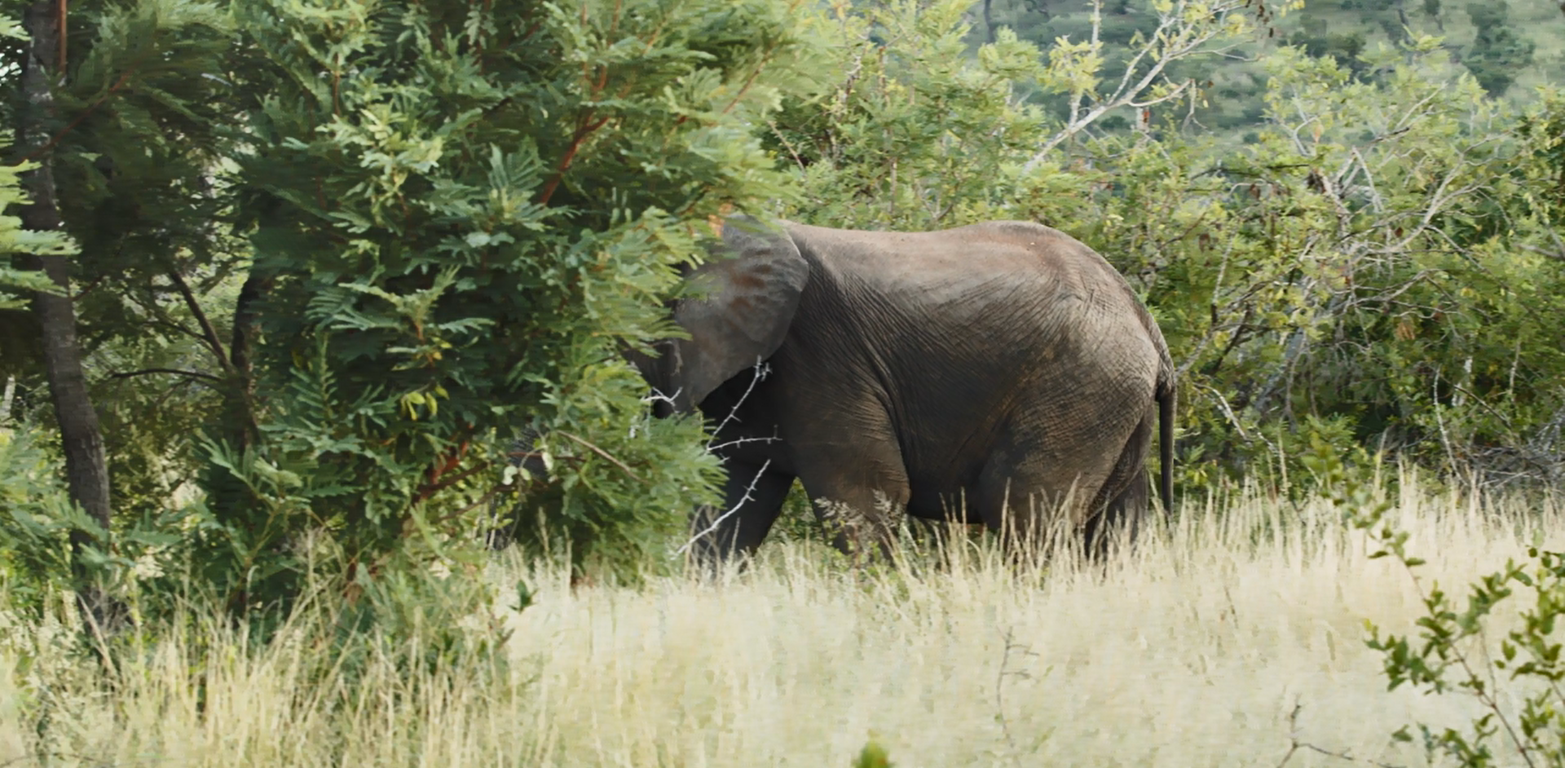
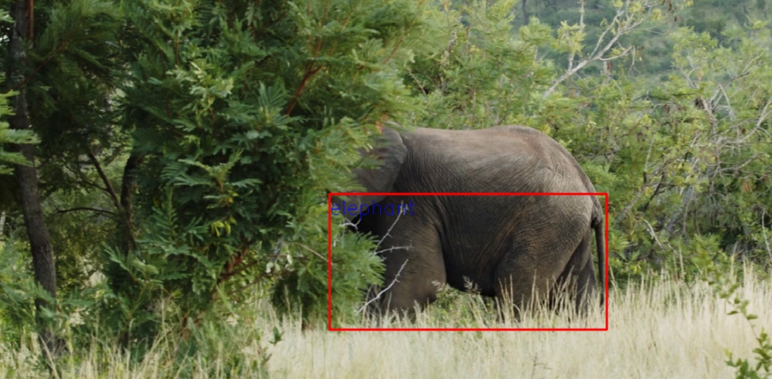
10. Screengrabs of Running Project Environment

Slide 14
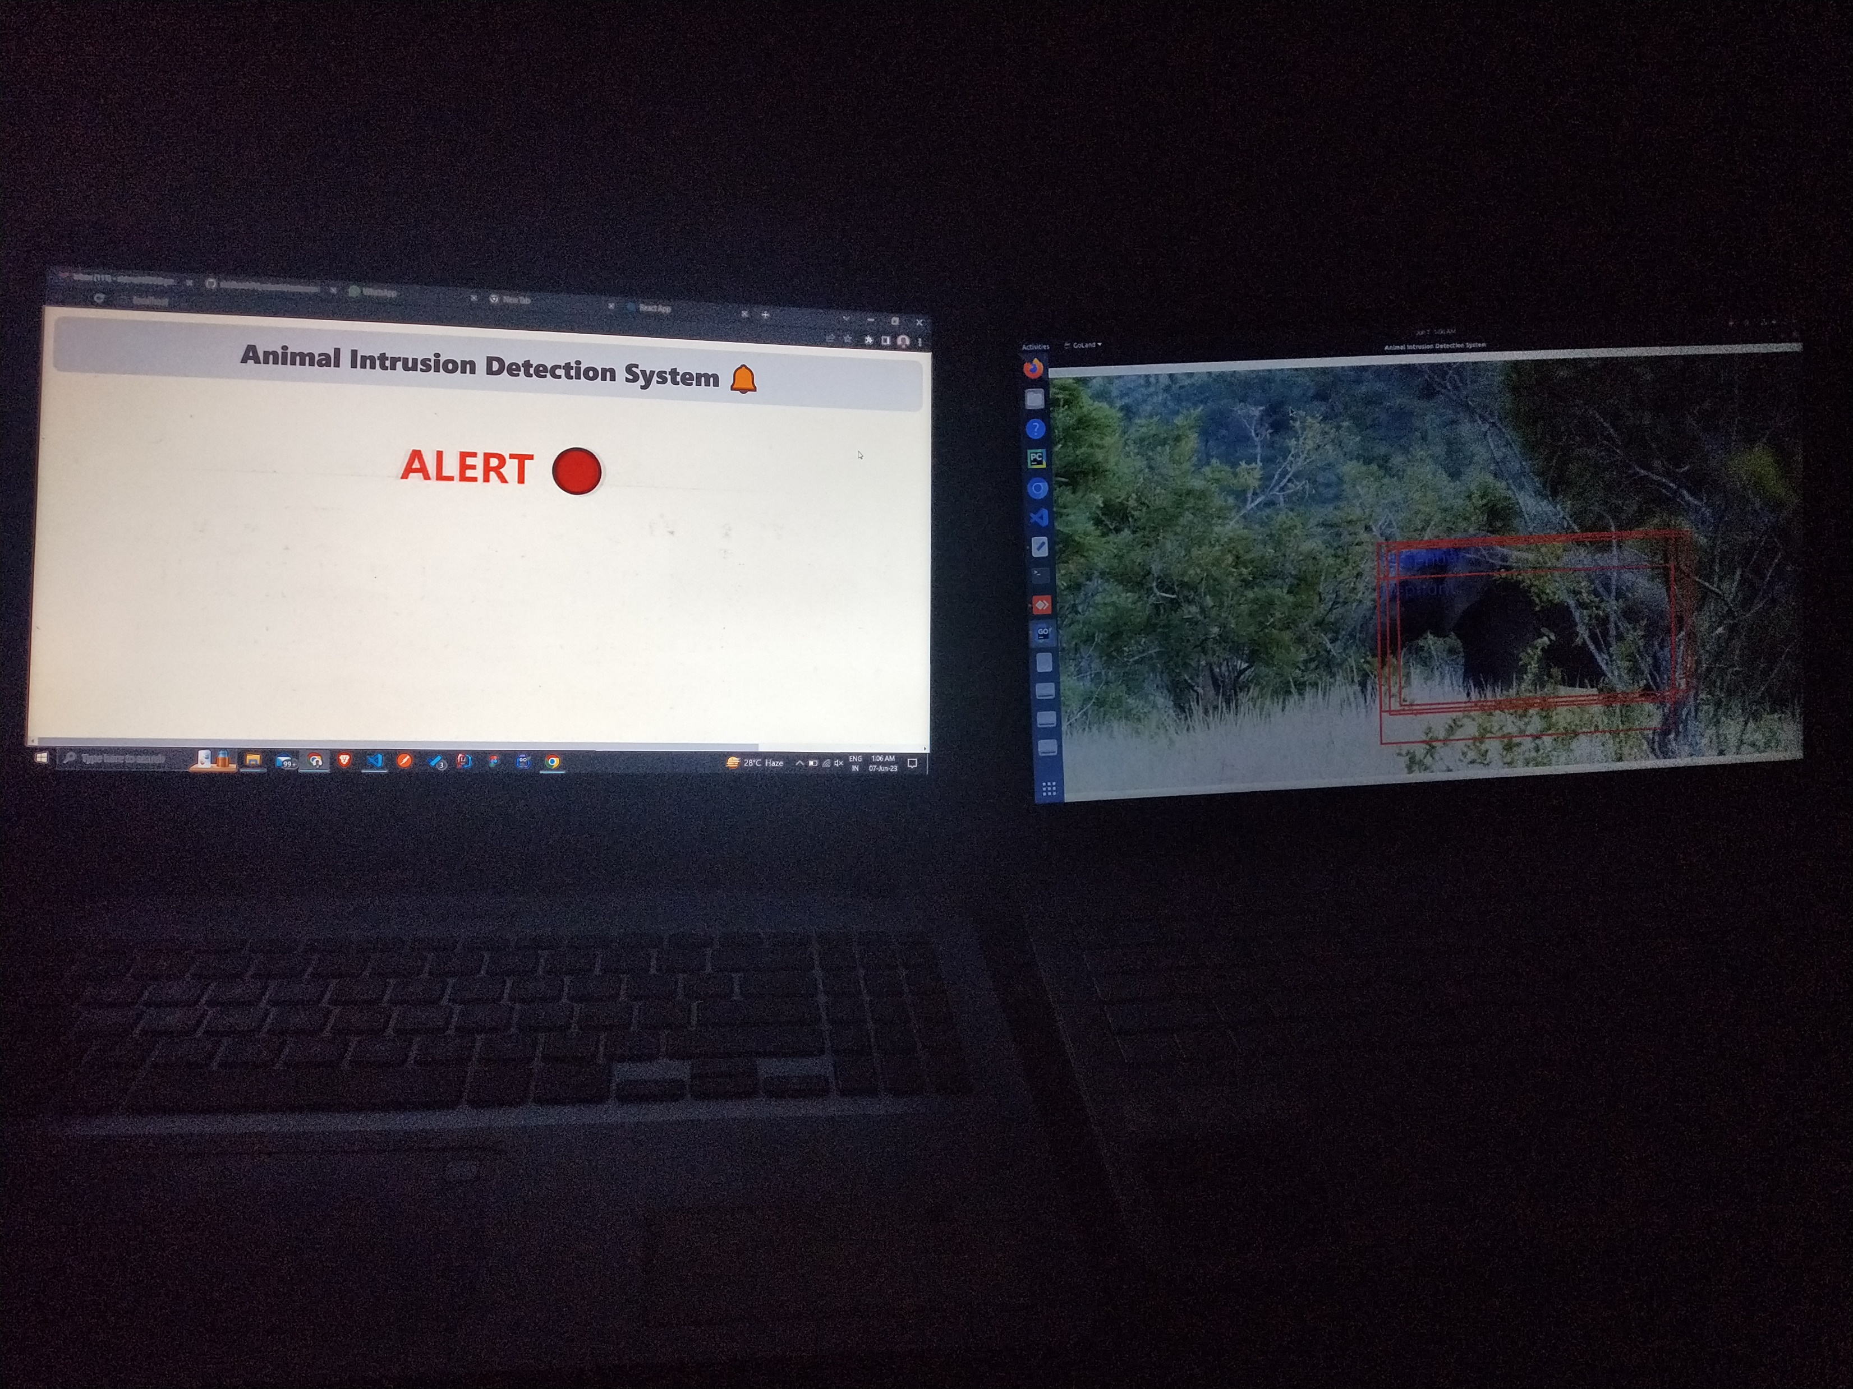
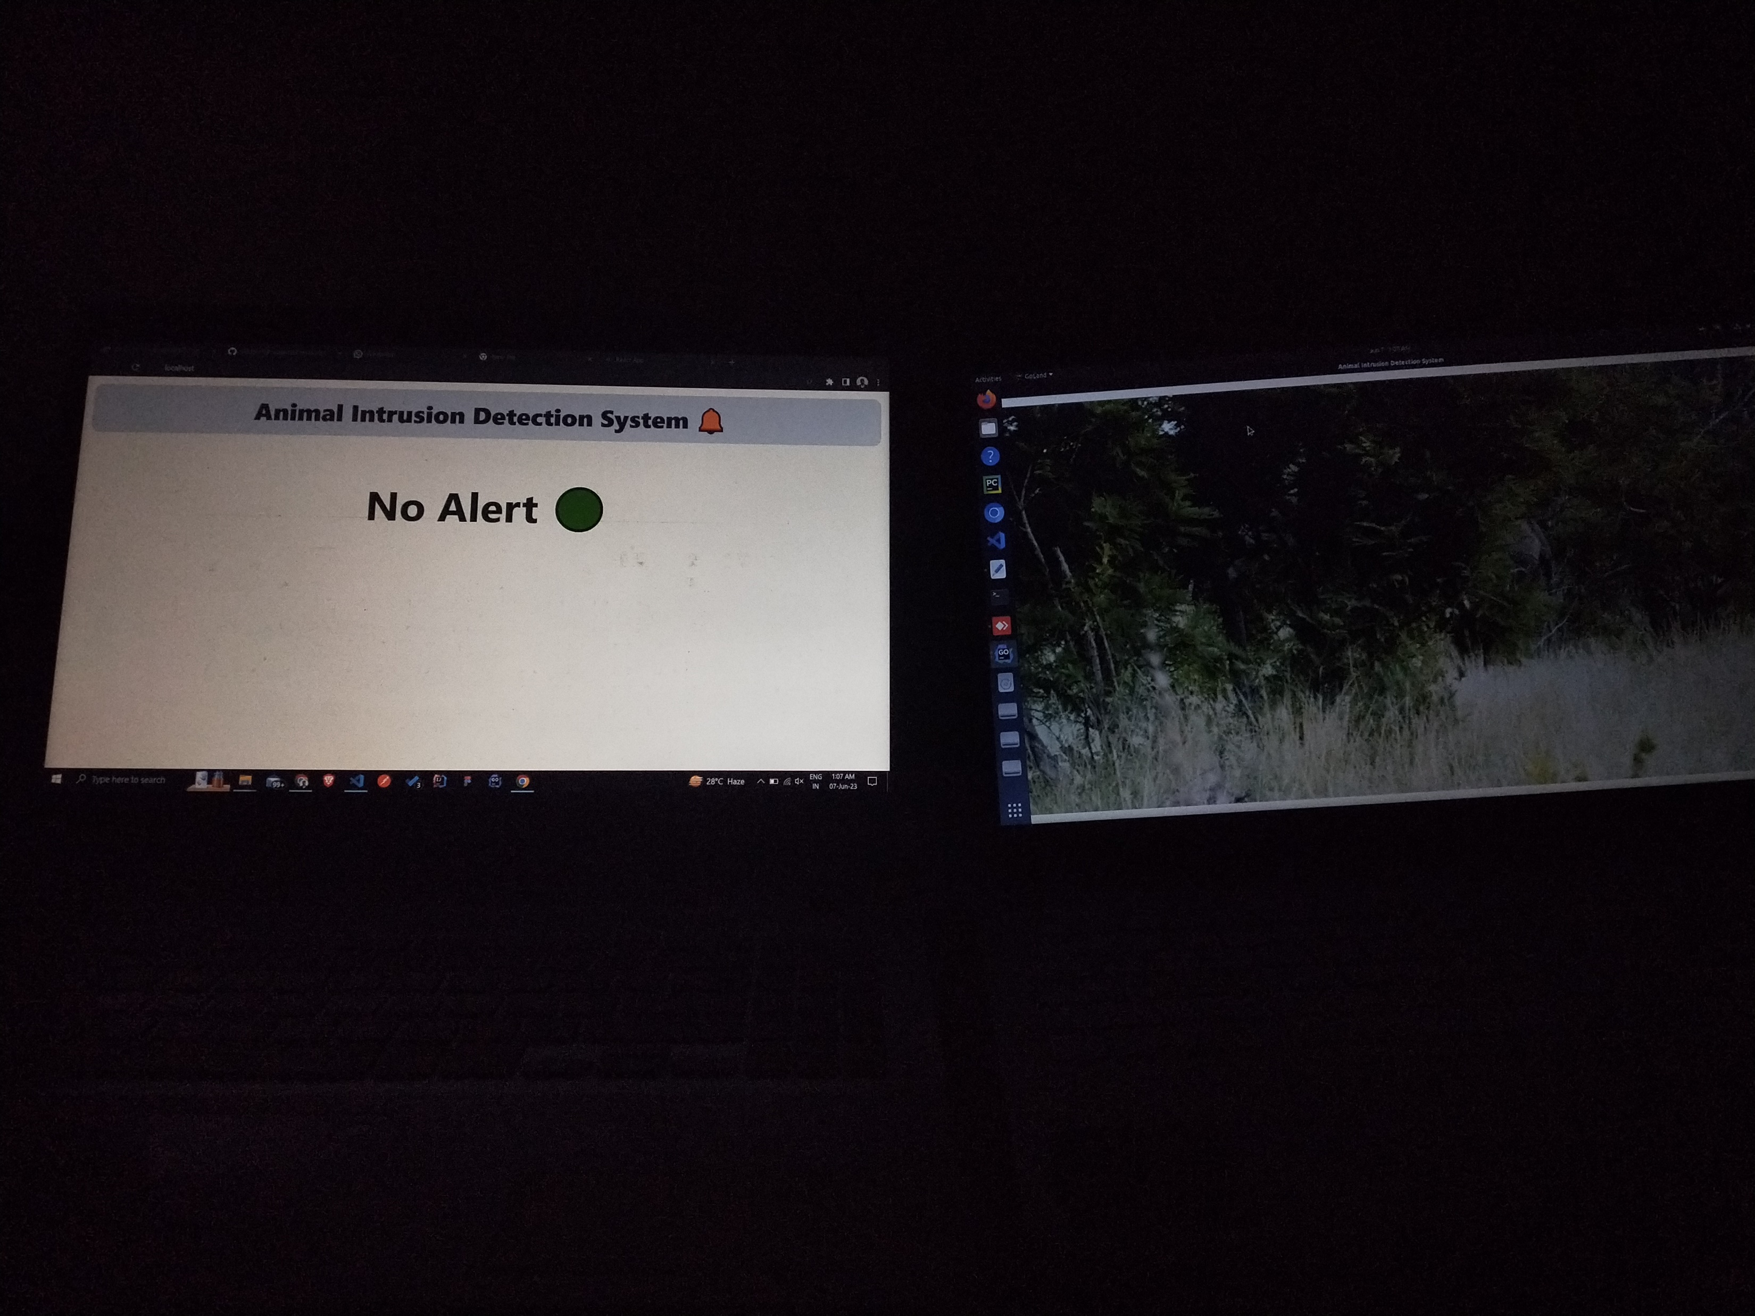
Live Demonstration(Detection + Alert)

Slide 15
11. Conclusion
Successful animal detection with our model
Real time Intra process communication between detection system, alert microservice and user interface(UI)
Trigger alert to inhabitants on Animal Detection with low latency
Improved intrusion detection methodology as compared to traditional method

Slide 16
12. References and Bibliography
Sajithra Varun, S., and G. Nagarajan. "DeepAID: a design of smart animal intrusion detection and classification using deep hybrid neural networks." Soft Computing (2023): 1-12.
Kahlon, Gursimran Singh, et al. "An intelligent framework to detect and generate alert while cattle lying on road in dangerous states using surveillance videos." Multimedia Tools and Applications (2023): 1-19.
Vatsavayi, Valli Kumari, and Nagaraju Andavarapu. "Identification and classification of wild animals from video sequences using hybrid deep residual convolutional neural network." Multimedia Tools and Applications 81.23 (2022): 33335-33360.
Velliangiri, S., and P. Karthikeyan. "Hybrid optimization scheme for intrusion detection using considerable feature selection." Neural Computing and Applications 32 (2020): 7925-7939.

Slide 17
THANK YOU
.

